Slide 1
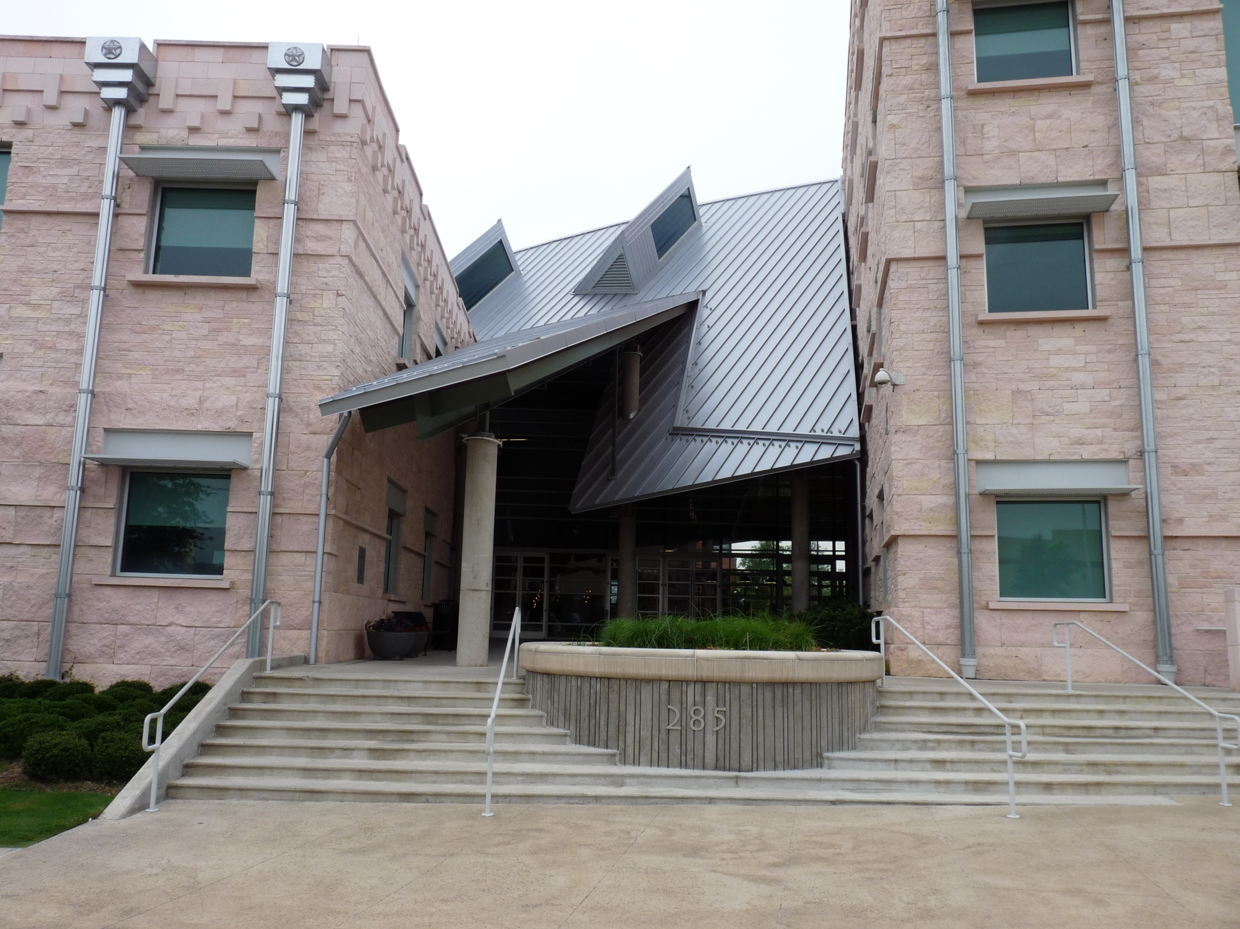
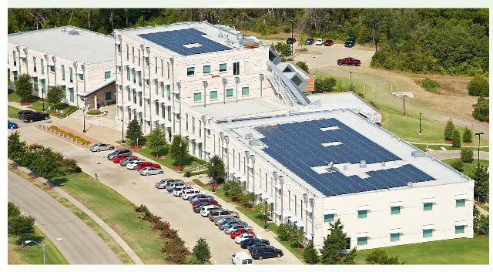
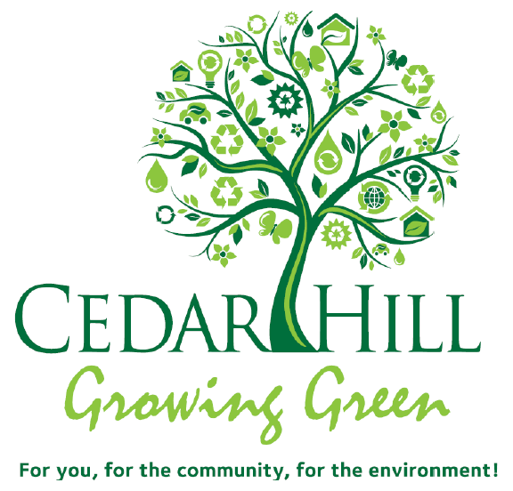
City of Cedar Hill, Texas
Sustainability Action Plan
2011-2016
December 10, 2013
December 10, 2013

Slide 2
Presentation Outline
1. History and Overview of Action Plan
2. Update on Accomplishments
3. Future Initiatives and City Council Direction

Slide 3
Sustainability Action Plan (SAP) History
2009 - City Council added various portions of Sustainability in their Strategic Plan as defined in Premier Statements:
    Clean
    Safe and Efficient Infrastructure
    Distinctive Character
    Vibrant Parks and Natural Beauty
    Strong and Diverse Economy
2010 - City Council authorized Staff to utilize Energy Efficiency Conservation Block Grant (EECBG) funds through US DOE to develop Energy Conservation Master Plan, which ultimately converted to SAP
2011 - City Council adopted 2011 – 2016 Sustainability Action Plan
Staff provides annual updates to City Council

Slide 4
2011-2016 Sustainability Action Plan (SAP)
Vision
We envision Cedar Hill as a regionally engaged sustainable community that manages resources wisely, conserves natural beauty, and promotes open space.
Mission
The City of Cedar Hill’s Mission is to invest in practical planning today for a sustainable community tomorrow.

Slide 5
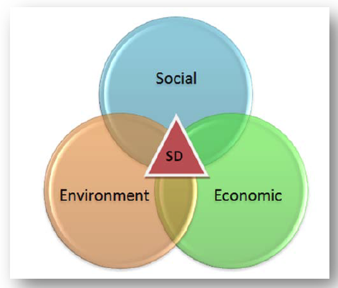
Sustainable Development Model
Triple Bottom Line ~ ROI based on three areas:
  Social
  Economic
  Environmental
Comparable to
Three P’s of Private
Sector
  People
  Planet
  Profit

Slide 6
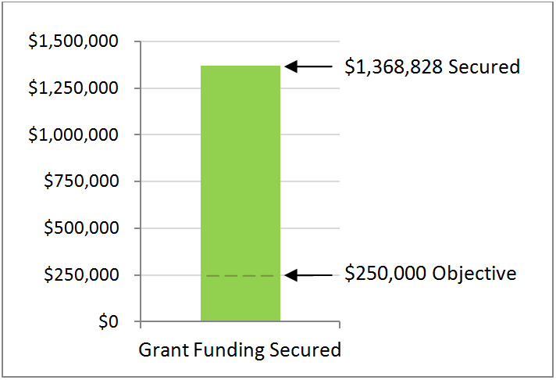
April 2012 SAP
Success Was Focused On…
Restructuring of Residential Waste Stream
  Recycling increased over 250% during first 3 months with 96-gallon carts
  Reduction of 52,000 drive miles equates to reduction of 87.9 metric tons of carbon emissions
Electric Vehicles and Charging Stations
Grants secured were over the projected $250k goal

Slide 7
April 2012 SAP
Success Was Focused On…
Launch of www.greencedarhill.com website
Growing Green branding
Renewable Technology
  152.64 kW Solar PV System
  4.335 kW vertical axis Wind Turbine

Slide 8
Solar Productivity Update
To Date:
Project online since July 1, 2011
563,045 kWh produced
Over $56,000 Savings
Equivalent to:
Planting over 10,000 Trees
45,606 gallons of gasoline saved
Annually, the System generates:
System Generates 210,030 kWh of electricity annually (8% total building use)
15 Average Houses powered for entire 12 months
$21,000 Annual savings

Slide 9
TODAY
Success Is Focused On…
Continued Recycling Initiatives
Grants secured
  $50,000 NCTCOG grant
Coordination of other City plans
Increased awareness of sustainability through www.greencedarhill.com website and branding

Slide 10
TODAY
Success Is Focused On…
Community partnerships and initiatives
Education and Outreach
Awards and Recognition

Slide 11
2011-2016 SAP PROGRESS
Year | Action ID | Action Item Description | Planning Horizon | Status | Update
Year 1 | Action 1.1 | Develop Organizational Structure and Work Groups | Short | Complete | ü
 | Action 2.1 | System for Sustainable Grant Procurement | Short | Ongoing | ü
 | Action 3.1 | Secure Strategic Partners | Short | Ongoing | ü
 | Action 6.2 | Create Sustainability Website | Short | Complete | ü
 | Action 15.4 | Improve Community Recycling | Short | Ongoing | ü
Year 2-3 | Action 4.1 | Employee Sustainability Training Program | Mid | Ongoing | ü
 | Action 5.1 | Develop Data Management Procedures | Mid | Yet to be Complete
 | Action 7.1 | Building Energy Audit & Retrofit Program | Mid | Ongoing | ü
 | Action 7.2 | EPA Energy Star Building Tracking Program | Mid | Yet to be Complete
 | Action 8.1 | Infrastructure Audit and Retrofit Program | Mid | Ongoing
 | Action 9.1 | Renewable Energy Pilot Program | Mid | Ongoing | ü
 | Action 10.1 | Green Fleet Optimization and Procurement Program | Mid | Ongoing | ü
 | Action 11.1 | Assess Water Rate Structure | Mid | Yet to be Complete | ü
 | Action 11.2 | Evaluate Automated Meter Reading technologies | Mid | Complete | ü
 | Action 12.1 | Municipal Recycling Program | Mid | Ongoing | ü
 | Action 15.1 | Community Web Portal | Mid | Ongoing | ü
 | Action 15.2 | Strategic Planning Workshops | Mid | Ongoing | ü
Year 3-5 | Action 6.1 | Secure EPA Energy Star Rating for Government Center | Long | Yet to be Complete
 | Action 13.1 | Secure Tree City USA Growth Award | Long | Yet to be Complete
 | Action 14.1 | Hold Planning Workshops to Introduce TOD as Energy HUB | Long | Ongoing | ü
 | Action 15.3 | Conduct Community Surveys and Studies | Long | Yet to be Complete
 | Action 15.4 | Community Garden Program | Long | Yet to be Complete

Slide 12
2013 SAP Update (Actions 11.1 and 11.2)
Objective 11: Improve Water Conservation in Municipal Operations
11.1 Assess Water Rate Structure
11.2 Evaluate Automated Meter Reading Technologies
UPDATE
11.1 Assess Water Rate Structure
    City Council assessment after 12 months AMI history
11.2 Evaluate Automated Meter Reading Technologies
    City Council approved AMI project on November 19, 2013
    Anticipated full implementation by Fall 2014
    Full implementation will reduce fleet by four (4) Ford Ranger vehicles
    Savings :
        48,000 drive miles/year
        2,848 gallons of gasoline
        68,860 pounds of carbon emission reduction

Slide 13
2013 SAP Update (Action 12.1)
Objective 12: Reduce Solid Waste and Increase Recycling in Municipal Operations
12.1 Municipal Recycling Program
UPDATE
12.1 Municipal Recycling Program
    Began January 1, 2012
    Enhanced level of service with 96-gallon carts
Annual Comparison against 2010 Baseline
 | 2010 Tons (Baseline) | 2011 Tons | 2011 Change from Baseline (Percent) | 2012 Tons | 2012 Change From Baseline (Percent) | 2013 Tons Estimate | 2013 Change from Baseline YTD* (Percent)
TOTAL | 1,756.40 | 1,989.50 | 13% | 5,410.08 | 208% | 5,167.00 | 194%*
*Year to Date – Full year not captured

Slide 14
2013 SAP Update (Action 12.1)
Objective 12: Reduce Solid Waste and Increase Recycling in Municipal Operations
12.1 Municipal Recycling Program
UPDATE
    October 1, 2013 - City began Mandatory Multi-Family Recycling program
    Recycling service provided to 9 complexes or 1,654 units in Cedar Hill
    Low Contamination rate reported by Waste Management
 | Weekly | Monthly
Recycle Volume in Units (Yards) | 120 yards | 520 yards
Recycle Volume by Weight (Tons) | 1.25 tons | 5.44 tons
Monthly Carbon Emission Diverted
18.62 metric tons*
*Equivalent to taking 48 cars off the road per month

Slide 15
2013 SAP Update (Action 12.1)
Objective 12: Reduce Solid Waste and Increase Recycling in Municipal Operations
12.1 Municipal Recycling Program
UPDATE
    Citywide Commercial Business Recycling is at all-time high
    21 Total Businesses (Pier 1; Northwood University, Tuesday Morning, Jack in the Box, Guitar Center, Pepwear, Starbucks, Cedar Hill Gov. Center, Party City, DSW, Buffalo Wild Wings, Dogwood Canyon, 24 Hr. Fitness, etc.)
 | Weekly | Monthly
Recycle Volume in Units (Yards) | 153 yards | 662 yards
Recycle Volume by Weight (Tons) | 1.6 tons | 6.9 tons
Monthly Carbon Emission Diverted
23.79 metric tons*
*Equivalent to taking 61 cars off the road per month

Slide 16
2013 SAP Update (Action 13)
Cedar Hill
is a manmade City
built in the
“Center of a Park”.
Objective 13: To Increase Vegetative Cover, Open Space, and Natural Beauty
UPDATE
    December, 2012 City Council adopted Parks, Open Space, Trails Vision Plan with goal to protect 20% of City dedicated to Parks and Open Space
    Cedar Hill is in the top 5% of cities
    Trails
    Bike Lanes
    Streetscapes
    All promote a healthy, walkable community

Slide 17
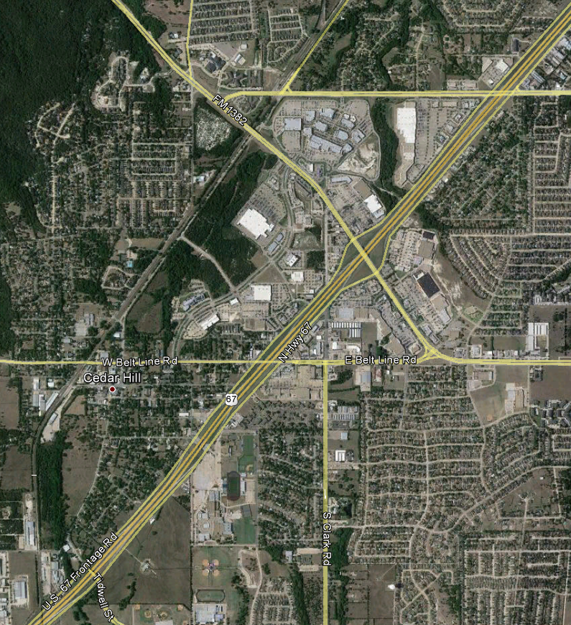
2013 SAP Update (Action 14.1)
Objective 14: Integrate Energy Efficiency & Renewable Technology into TOD plans
14.1 Planning workshops to evaluate Green TOD
UPDATE
    The City Center Advisory Committee and the Planning Department has conducted Seven (7) workshops to determine future TOD planning
    Next Steps:
      Phase I was adopted by City Council March 23, 2010
      Phase II kickoff was December 13, 2012
      Phase II to be considered by City Council Spring ‘14

Slide 18
Future initiatives
Projects
Education
Grants
Plan Integration

Slide 19
2014 SAP NEXT STEPS ~ Projects
  Update Citywide Green House Gas Inventory – last done in 2009
  Implementation of AMI
  Lighting Retrofit Projects
    Potential projects:
      Recreation Center gymnasium and parking lot
      Government Center parking lot
      Library
      Senior Center
    Evaluate Options to Pursue Potential Projects

Slide 20
2013 SAP NEXT STEPS ~ Education
Objective 15: Community Sustainability Education & Extension Program
15.1 Community Web portal
15.3 Community Survey
15.4 Community Garden
UPDATE
    15 Community Sustainability Education
      Staff propose to offer the public a Self-Guided tour of the sustainability exhibits located at the Government Center as one aspect of the City’s sustainability education program
        Ex: Wind Turbine Video
        Other areas include: Solar PV system, Solar powered trash can, EV stations and Electric vehicles, Texas native / Zeroscape landscaping, Anti-Idling, etc.
        Global Water exhibit
    15.3 Community Survey
    15.4 Community Garden…a HUGE success

Slide 21
2013 SAP NEXT STEPS ~ Grants
Second round of Bureau of Reclamation - AMI Smart Meter grant Phase II
Second round of NCTCOG Waste Diversion grants

Slide 22
Plan Integration
  Urban Conservation Plan with Audubon
  City Center Plan
  Parks, Open Space, Trails Vision Plan
  Library Expansion Plan
  Economic Development Strategic Plan

Slide 23
Future Sustainability for Cedar Hill
Becoming a Way of Life
Transition from a Task Oriented Plan to a Strategic Planning Oriented Plan
Involves All departments AND the community

Slide 24
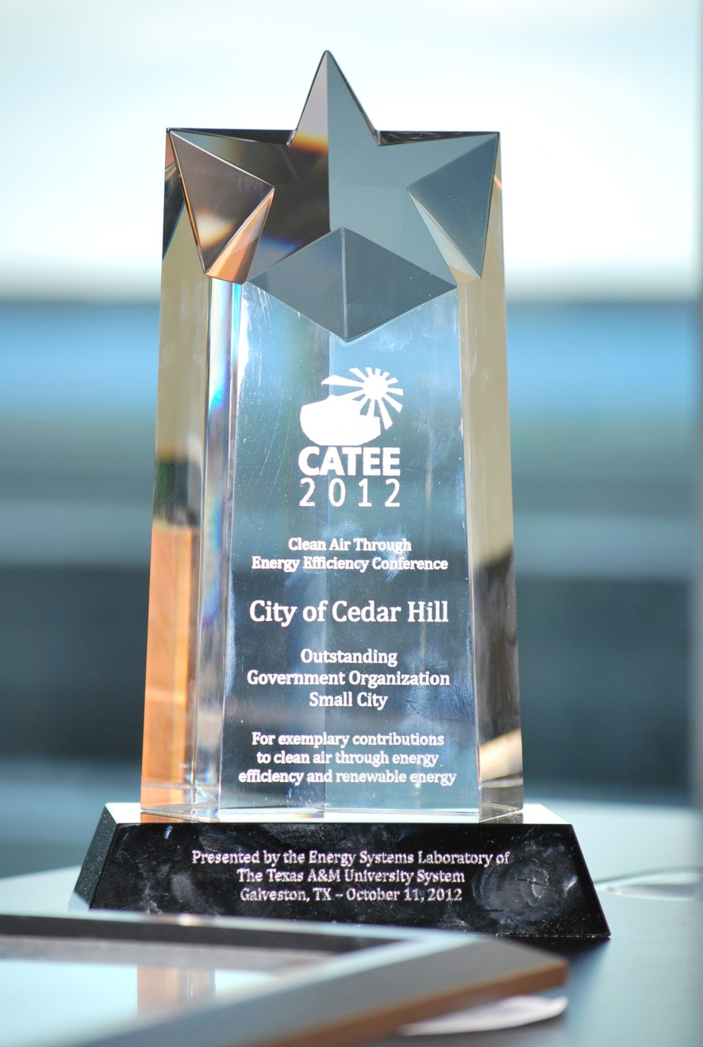
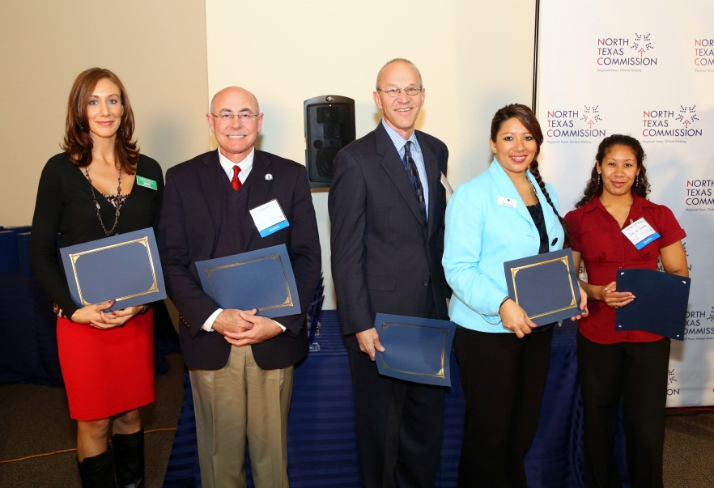
Awards and Recognition
CATEE Award
Working for Clean Air Awards Certificate of Merit

Slide 25
13 City Comparison of SAP Planning
None of our Survey cities have comprehensive Sustainability Action Plans
However, two survey cities (DeSoto and Grapevine) have plans related to energy conservation
Other cities in the metroplex such as Coppell and Southlake are developing Sustainability Action Plans
Cities that have comparable plans:
  Denton, Texas
  Sarasota, California
  Dubuque, Iowa

