Slide 1


2024 Community Survey Cedar Hill, Texas
Presented by
March 2025

Slide 2
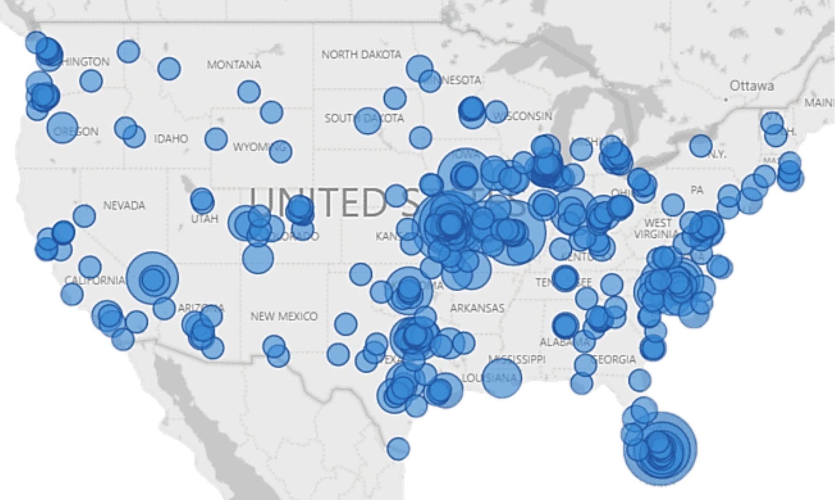
ETC Institute is a National Leader in Market Research
for Local Governmental Organizations
For more than 40 years, our mission has been to help city and county governments gather and use survey data to enhance organizational performance.
More Than 3,000,000 Person’s Surveyed Since 2015 for More Than 1,000 Communities in 49 States

Slide 3
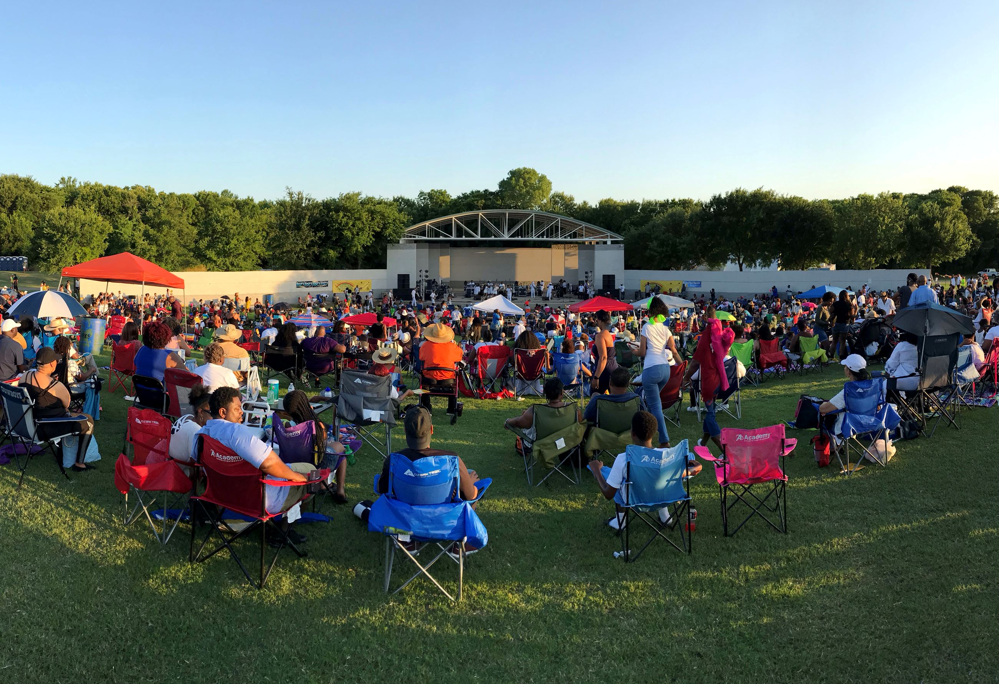
Agenda
Purpose and Methodology
What We Learned
Major Findings
Summary
Questions

Slide 4
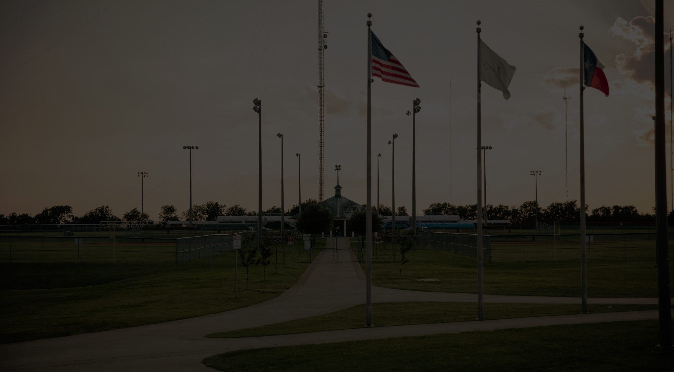
Purpose
To objectively assess resident satisfaction with the delivery of major City services
To help determine priorities for the community
To measure trends from previous surveys
To compare the City’s performance with other communities regionally and nationally

Slide 5
Methodology
Survey Description
Seven-page survey; included many of the same questions as previous surveys
5th Community Survey conducted for the City of Cedar Hill
Method of Administration
By mail and online to randomly selected sample of City residents
Sample Size
401 completed surveys
Margin of error: +/- 4.9% at the 95% level of confidence

Slide 6
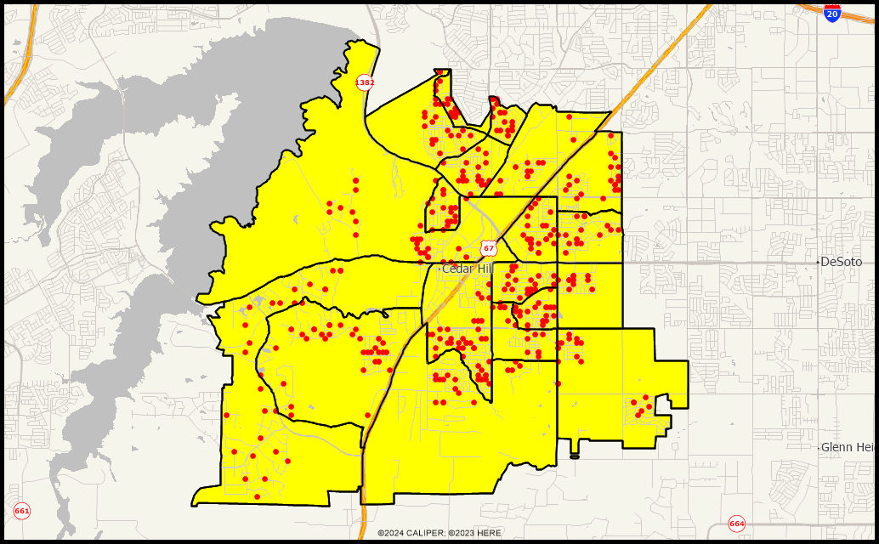
Location of Survey Respondents
Good representation throughout the City
Demographics of survey respondents reflects the actual population of the City
6

Slide 7
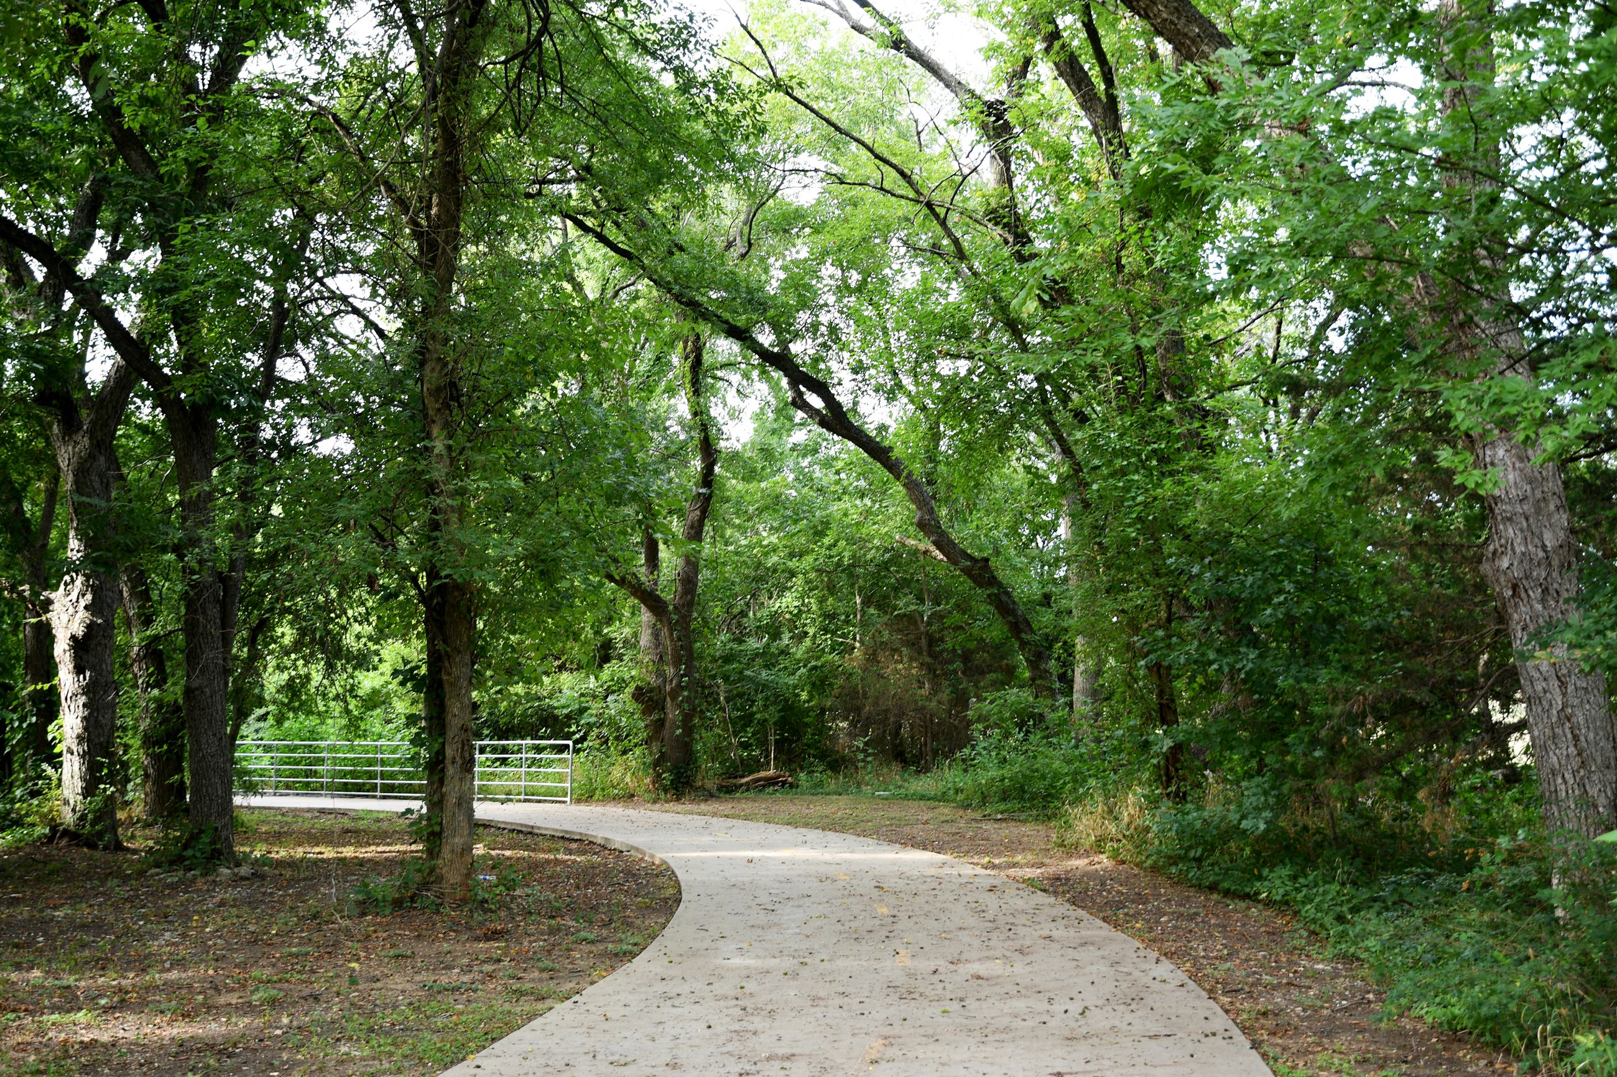
Residents Have a Positive Perception of the City of Cedar Hill
What We Learned
79% Are Satisfied with Cedar Hill as a Place to Live
Satisfaction with City Services Is Much Higher in Cedar Hill Than Other Cities
Cedar Hill Rates Above the U.S. Average in 54 of 58 Areas
Satisfaction with the Overall Quality of Customer Service Is 33% Above the U.S. Average
Satisfaction with Communication with the Public Is 33% Above U.S. Average

Slide 8
Satisfaction Ratings Remain High, and Are Similar to Previous Surveys
What We Learned
Top Overall Priorities
Traffic Flow and Congestion Management
Maintenance of City Streets, Buildings, and Facilities
Enforcing Codes and Ordinances

Slide 9
Topic #1
Residents Have a Positive Perception
of the City
9

Slide 10
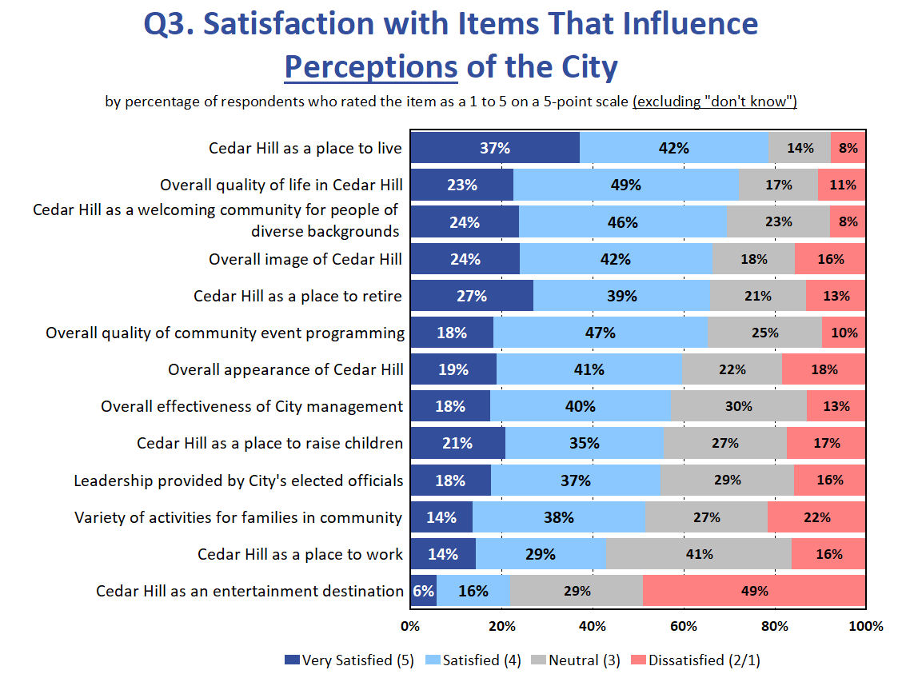
Most Residents Are Satisfied with Cedar Hill as a Place to Live
10

Slide 11
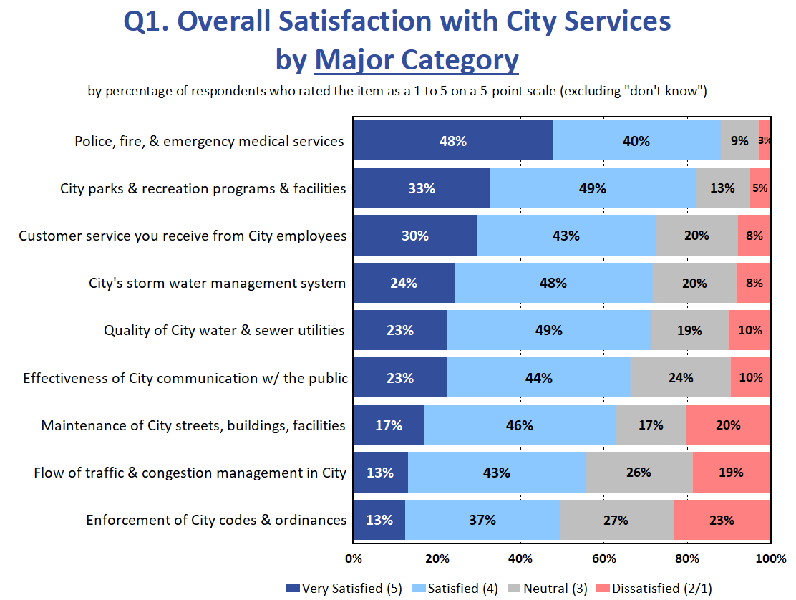
Residents Gave High Ratings to City Services
11

Slide 12
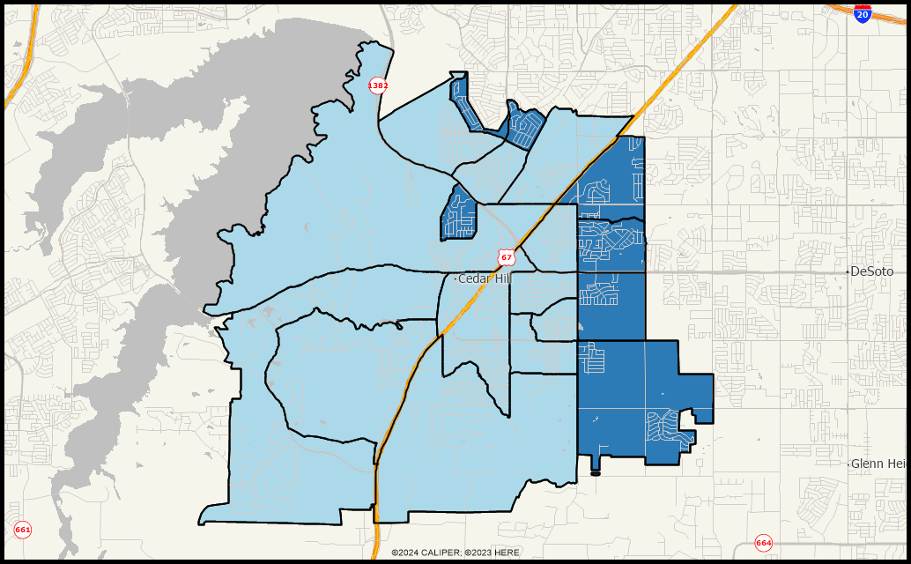
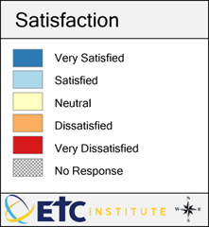
Cedar Hill as a Place to Live All Areas Are in Blue, Indicating That Residents in All Parts of the City Are Satisfied with Cedar Hill as a Place to Live
12

Slide 13
Topic #2
Satisfaction with City Services Is Much Higher in Cedar Hill Than Other Communities
13

Slide 14
Benchmarking Analysis
Cedar Hill Rates Above the U.S. Average in 54 of the 58 Areas
Cedar Hill Rates Significantly Higher (5% or More) in 51 Areas
Cedar Hill Rates Above the Texas Average in 53 of the 58 Areas
Cedar Hill Rates Significantly Higher (5% or More) in 51 Areas
14

Slide 15
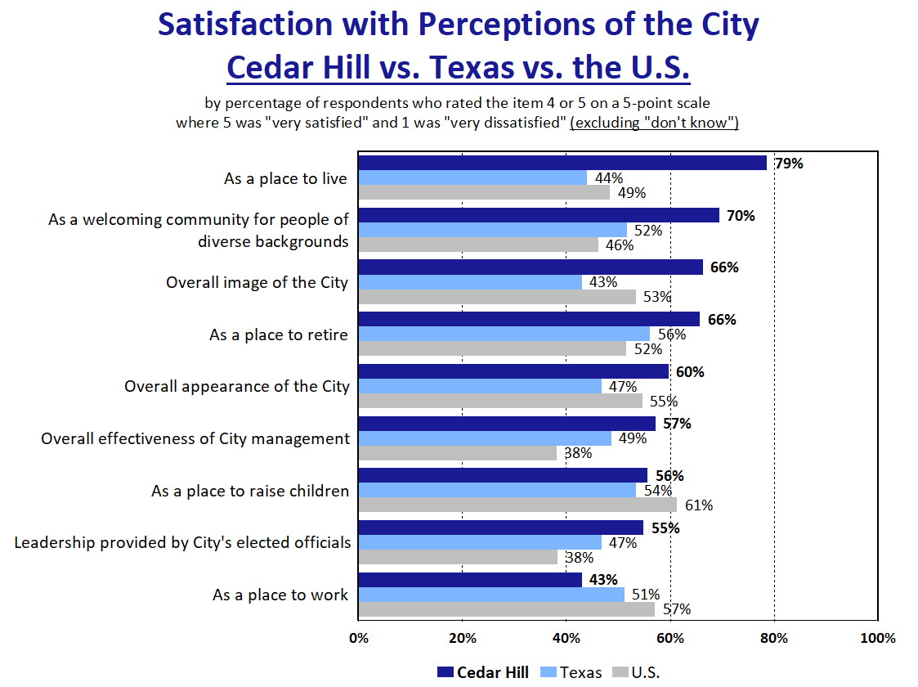
Cedar Hill Rates 30% Above the U.S. Average as a Place to Live
15

Slide 16
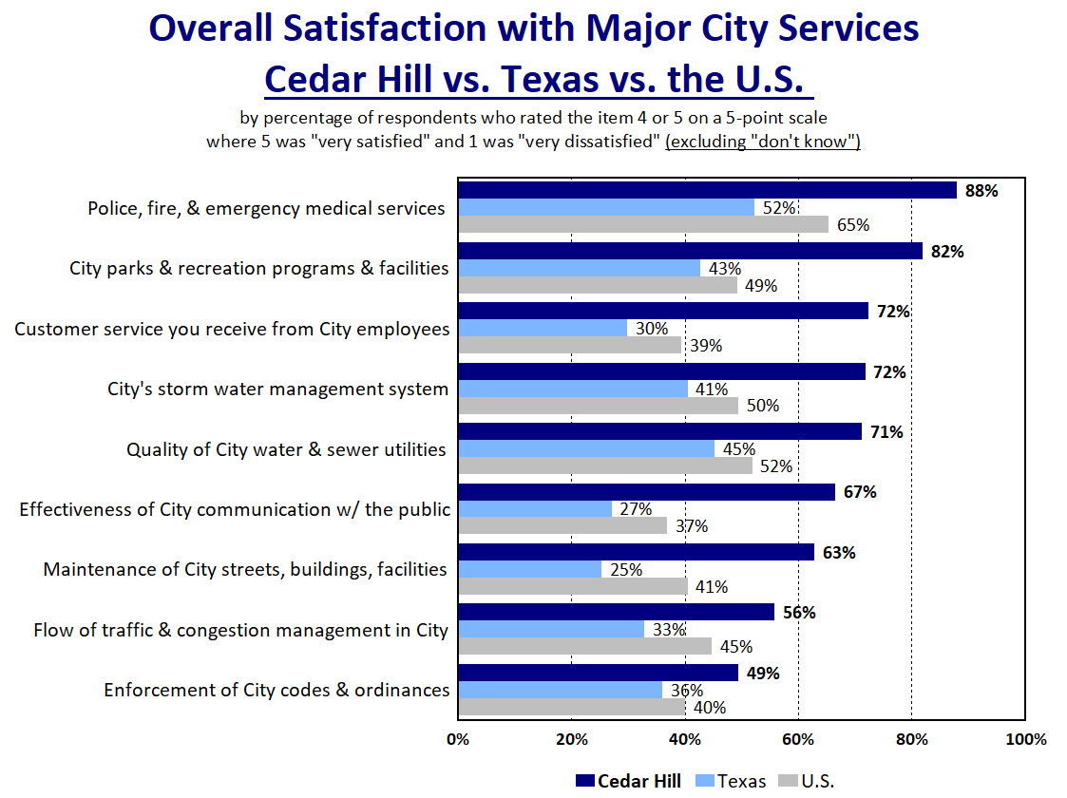
Satisfaction with Customer Service Rates 33% Above the U.S. Average
Satisfaction with Communication Rates 30% Above the U.S. Average
Cedar Hill Rates Significantly Above the U.S. Average in All 9 Major Categories of City Services
16

Slide 17
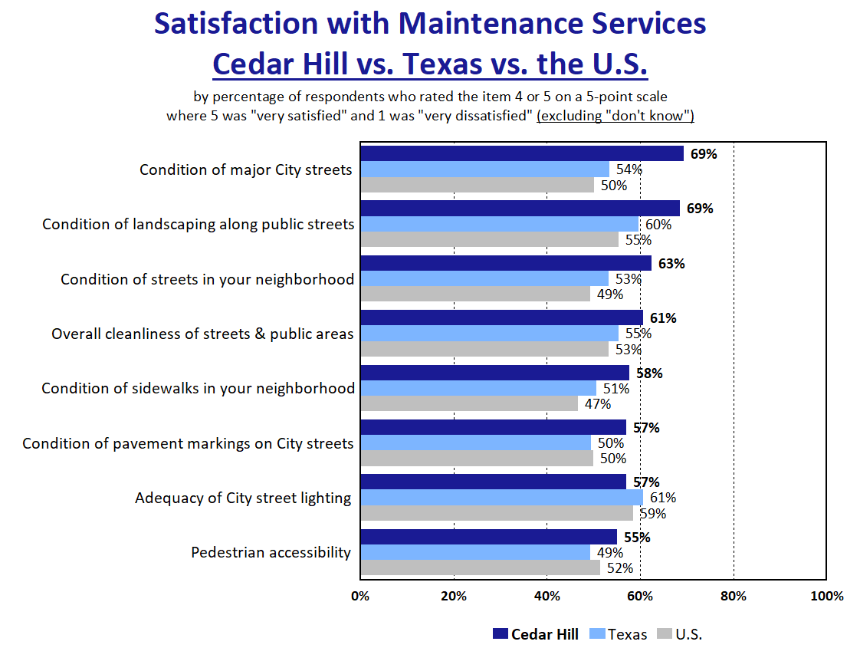
Cedar Hill Rates Significantly Above the U.S. Average in 6 of 8 Areas of Maintenance
17

Slide 18
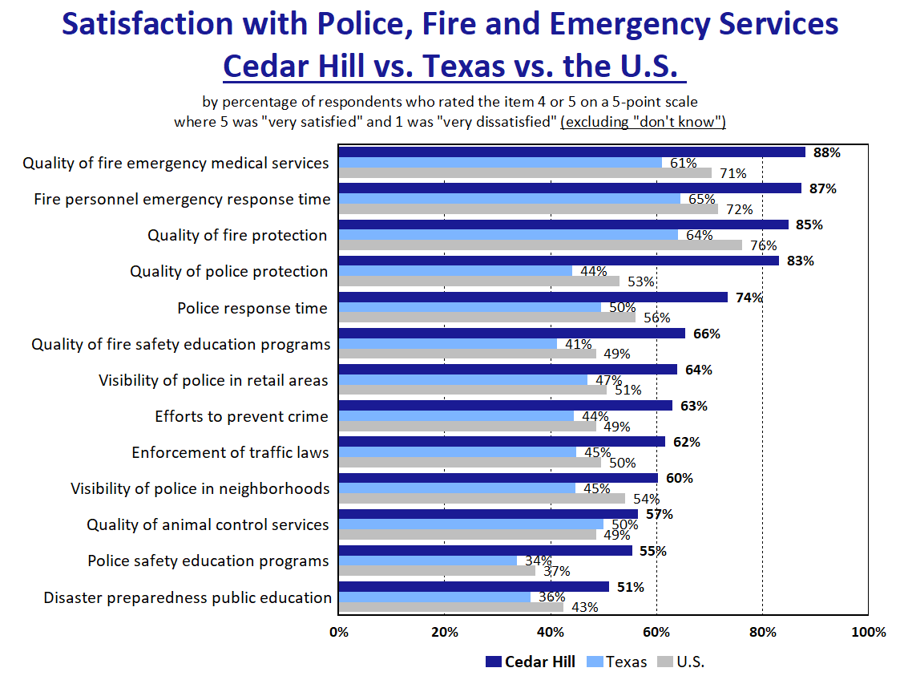
Cedar Hill Rates Significantly Above the U.S. Average in All 13 Areas of Public Safety
18

Slide 19
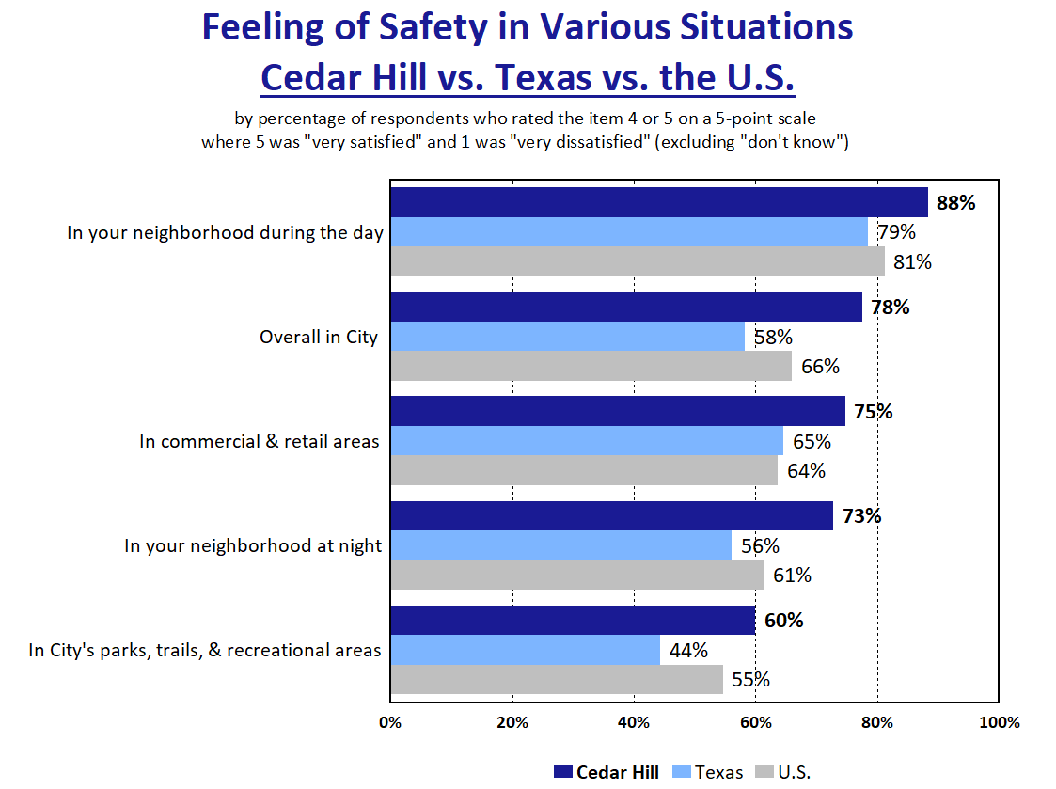
Residents Feel Safe in Cedar Hill
19

Slide 20
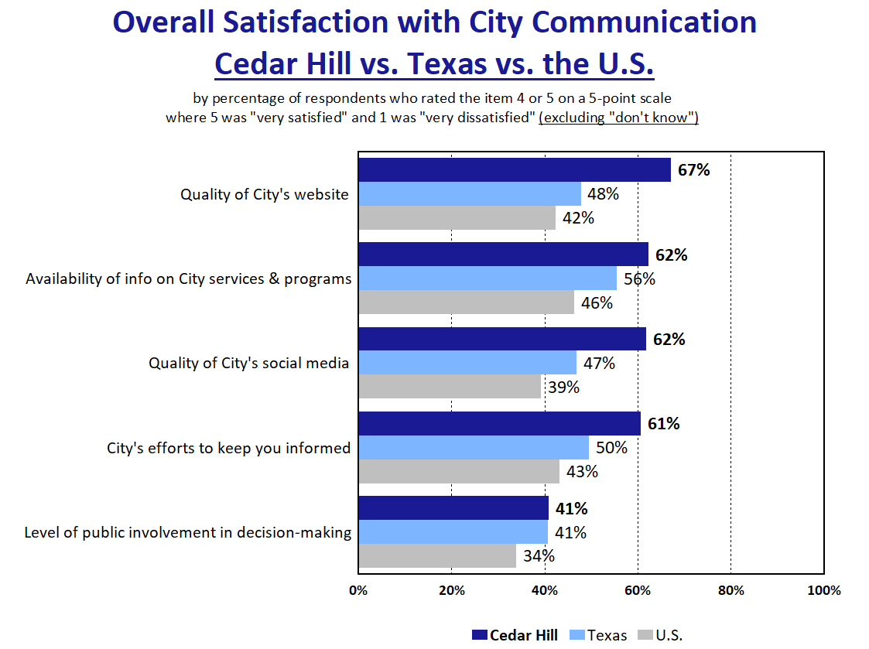
Cedar Hill Rates Significantly Above the U.S. Average in 4 of 5 Areas of Communication
20

Slide 21
Topic #3
Satisfaction Ratings Remain High, and Are Similar to the Previous Survey in 2022
21

Slide 22
Trend Analysis
Notable Increases in Satisfaction Since 2022:
Amount of Space in the Library
Quality of the Condition of Library Facilities
Quality of Computers/Mobile Electronic Devices at the Library
Availability of Computers/Mobile Electronic Devices at the Library
Quality and Condition of Swimming Pools
Notable Decreases in Satisfaction Since 2022:
Efforts to Remove Dilapidated Services
Efforts to Identify Abandoned/Unsecured Properties
Overall Quality of Local Schools
Overall Appearance of Cedar Hill
Quality of the City’s MyCedarHill Mobile App
22

Slide 23
Topic #4
Top Priorities
23

Slide 24
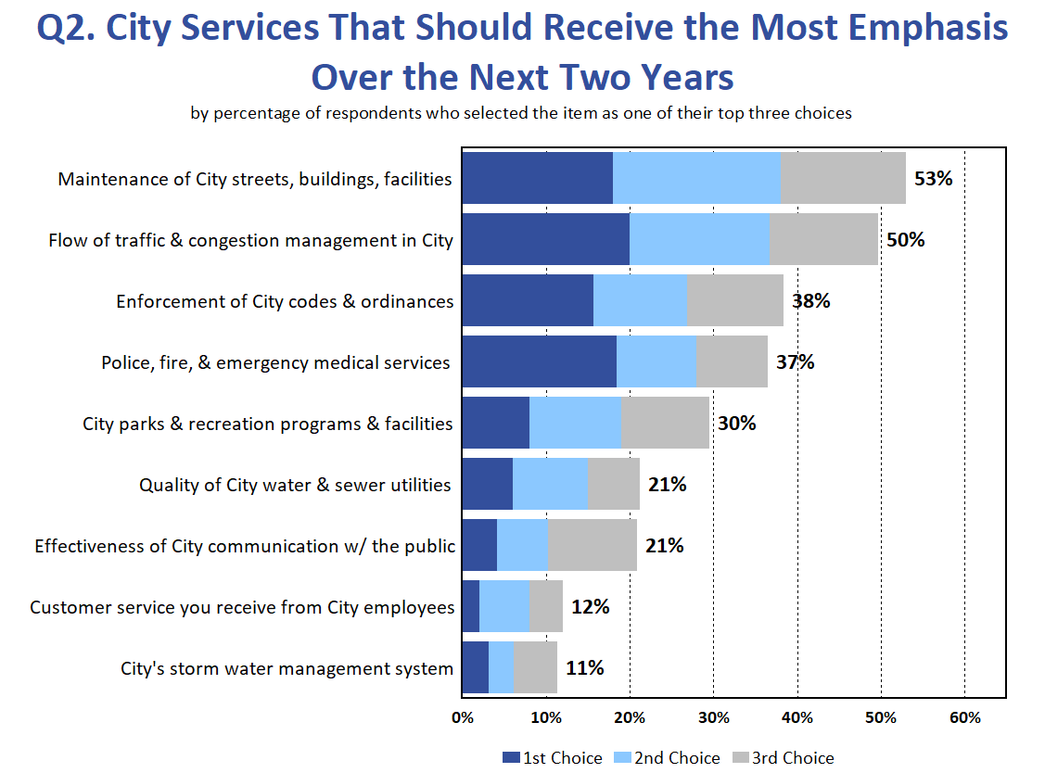
24

Slide 25
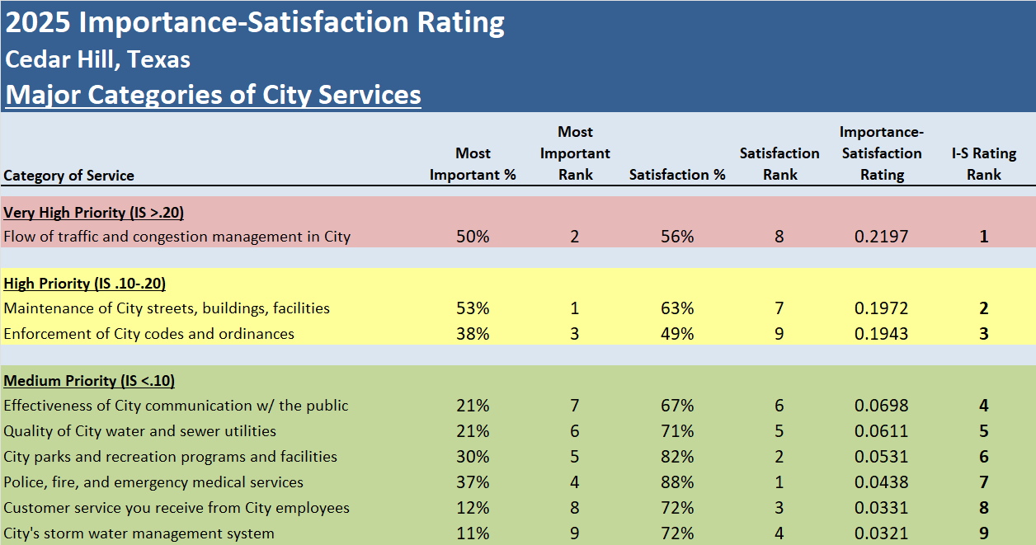
Overall Priorities
25

Slide 26
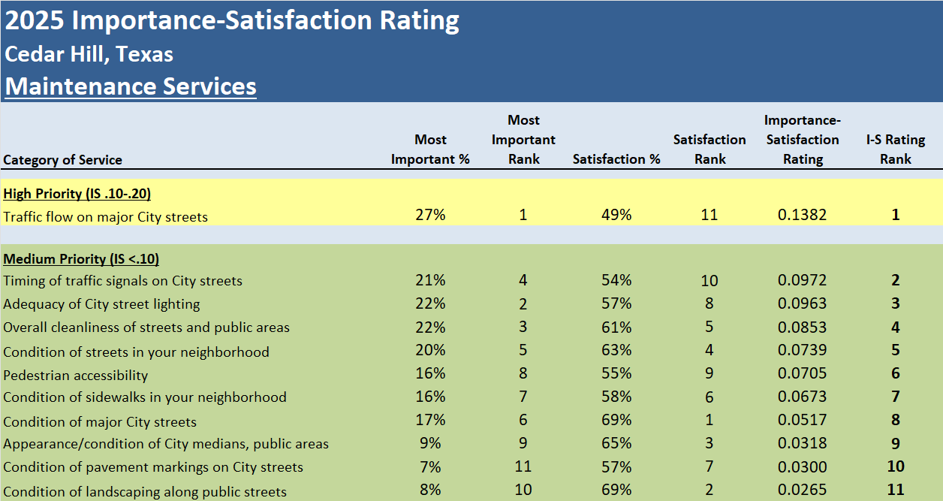
Maintenance Priorities
26

Slide 27
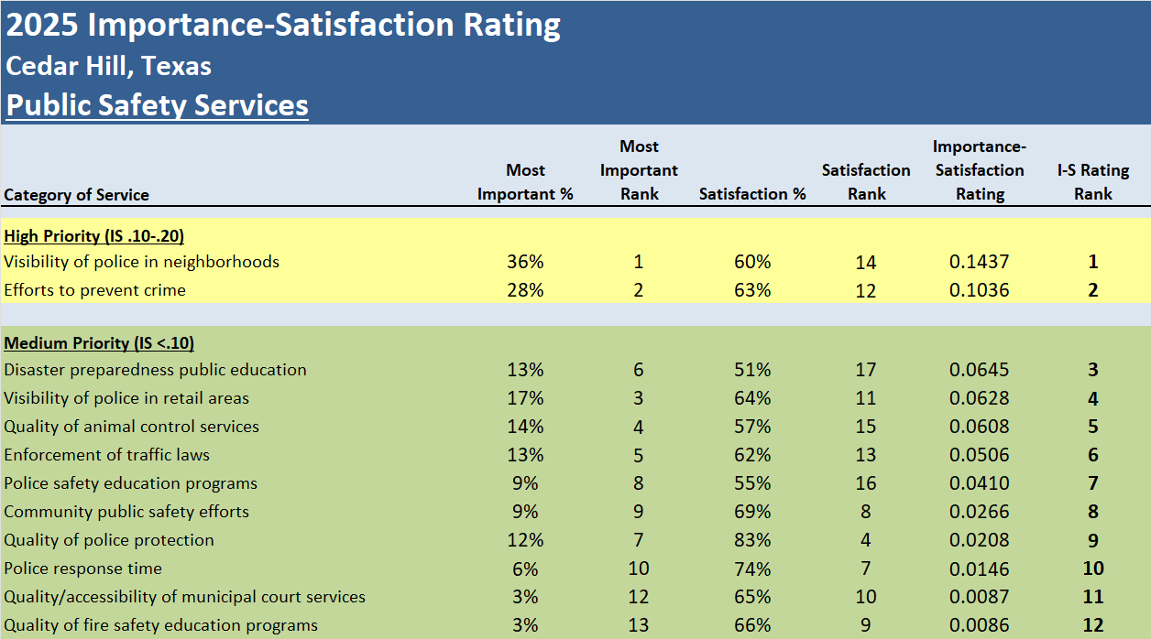
Overall Priorities
27

Slide 28
Residents Have a Positive Perception of the City of Cedar Hill
Summary
79% Are Satisfied with Cedar Hill as a Place to Live
Satisfaction with City Services Is Much Higher in Cedar Hill Than Other Cities
Cedar Hill Rates Above the U.S. Average in 54 of 58 Areas
Satisfaction with the Overall Quality of Customer Service Is 33% Above the U.S. Average
Satisfaction with Communication with the Public Is 33% Above U.S. Average

Slide 29
Satisfaction Ratings Remain High, and Are Similar to Previous Surveys
Summary
Top Overall Priorities
Traffic Flow and Congestion Management
Maintenance of City Streets, Buildings, and Facilities
Enforcing Codes and Ordinances

Slide 30
Questions?
Thank You!!
30

